Slide 1
Polygons
Nancy Victor
Assistant Professor
SITE, VIT University,
Vellore

Slide 2
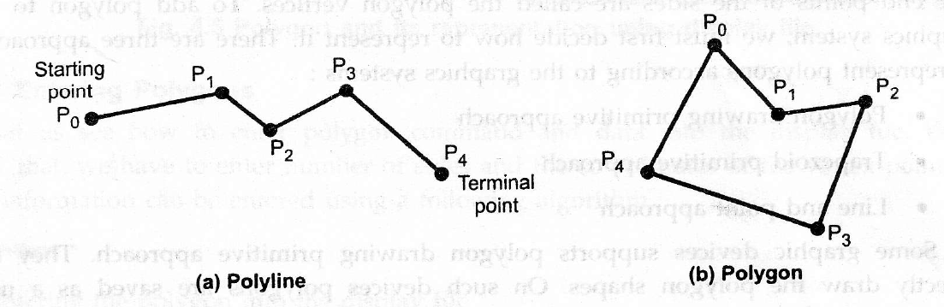
Introduction
A poly line is a chain of connected line segments.
The first vertex is called the initial or starting point and the last vertex is called the final or terminal point.
When starting point and terminal point of any poly line is same, i.e. when a poly line is closed then it is called polygon.

Slide 3
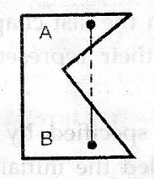
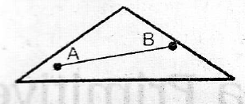
Types of Polygon
The classification of polygons is based on where the line segment joining any two points within the polygon is going to lie. There are two types:
  Convex Polygon
  Concave Polygon
A convex polygon is a polygon in which the line segment joining any two points within the polygon lies completely inside the polygon.
A concave polygon is a polygon in which the line segment joining any two points within the polygon may not lie completely inside the polygon.

Slide 4
Representation of Polygons
There are three approaches to represent polygons according to the graphics systems :
Polygon drawing primitive approach: They can directly draw the polygon shapes. On such devices polygons are saved as a unit.
Trapezoid primitive approach: Every polygon is broken up into trapezoids and it is represented as a series of trapezoids.
Line and point approach: Polygons are represented using lines and points.

Slide 5
Inside-Outside Test
When filling polygons we should decide whether a particular point is interior or exterior to a polygon.
  Odd-Even Rule/ Odd Parity Rule/ Even-odd Rule
  Non-zero Winding Number Rule

Slide 6
Odd-Even Rule
Draw a line from any position P to a distant point outside.
Count the number of intersections between that line and the polygon edges.
If there are odd number of intersections, then P is an interior point.
If there are even number of intersections, then it is an exterior point.
If the intersection point is vertex of the polygon, look at the other end points of the segments which meet at that vertex.
If these points lie on the same side of the constructed line, count this as two intersection points. Otherwise, count the vertex point as one intersection point.

Slide 7
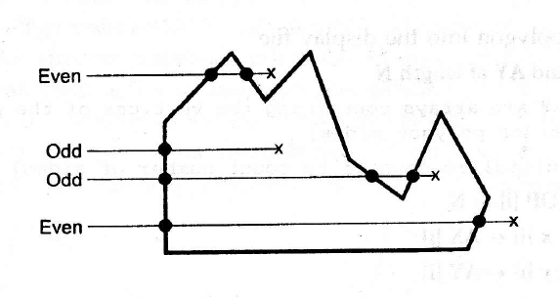
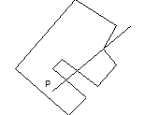
Odd-Even Rule
In second figure, the end points of the vertex are on different sides. Count this as one intersection hence there are 3 intersections in total, that means odd number of intersections. So, the point p is an interior point.

Slide 8
Non-zero winding Number Rule
Draw a line from any position P to a distant point outside.
Mark all the edges of the polygon in anti-clock wise direction.
Initialize the winding number as zero.
Make sure that the line segment is not passing through any polygon vertices.
Add 1 to the winding number every time we intersect a polygon edge that crosses the line from right to left (bottom to top), and subtract 1 every time we intersect an edge that crosses from left to right (top to bottom).
If the winding number is nonzero, P is defined to be an interior point. Otherwise, P is taken to be an exterior point.

Slide 9
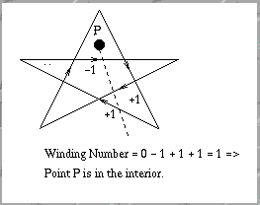
Non-zero winding Number Rule

Slide 10
Polygon Filling
Polygon Filling is the process of coloring the area of a polygon.
Two approaches:
  Start from a seed point and high light outward from this point. This approach is called seed fill approach.
  Applying the inside test. This approach is called scan line approach.

Slide 11
Polygon Filling
Seed Fill Algorithms:
These are again classified as flood fill algorithms and boundary fill algorithms.
The polygon defined by the total number of pixels is called interior defined, and the algorithms used for filling the area are known as flood fill algorithms.
The polygon defined by the bounding pixels that outline the polygon is called as boundary defined, and the algorithms used are known as boundary fill algorithms.

Slide 12
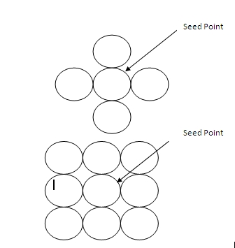
Boundary Fill Algorithm
In Boundary filling a seed point is fixed, and then neighboring pixels are checked to match with the boundary color.
Then, color filling is done until boundary is reached.
A region may be 4 connected or 8 connected.

Slide 13
Boundary Fill Algorithm
Procedure for filling a 4- connected region:
Color is specified by parameter fill color (f-color) and boundary color is specified by boundary color (b-color).
getpixel() function gives the color of specified pixel and putpixel() fills the pixel with particular color.

Slide 14
Boundary Fill Algorithm (4 connected)
Steps:
Enter the fill color code(f_color) and border color(b_color) code.
Call the procedure boundary_fill.
boundary_ fill (x,y, f_color, b_color)
{
If ( getpixel (x,y) != b_color && getpixel (x,y) != f_color)
putpixel(x,y,f_color);
boundary_fill( x+1, y, f_color, b_color);
boundary_fill( x, y+1, f_color, b_color);
boundary_fill( x-1, y, f_color, b_color);
boundary_fill( x, y-1, f_color, b_color);
}
}

Slide 15
Flood Fill Algorithm
There are some cases where we want to fill an area which is not defined by a single boundary color.
For situations like these, Flood fill algorithm is used.
Here the process is started in a similar way by examining the colors of neighboring pixels.
But instead of matching it with a boundary color a specified color is matched.

Slide 16
Flood Fill Algorithm (8 connected)
Steps:
Enter the old color code(old_color) and new color(new_color) code.
Call the procedure flood_fill.
flood_ fill (x,y, old_color, new_color)
{
If(getpixel(x,y)==old_color&&getpixel(x,y)!=new_color)
putpixel(x,y,new_color)
flood_ fill (x+1, y, old_color, new_color)
flood_ fill (x-1, y, old_color, new_color)
flood_ fill (x, y+1, old_color, new_color)
flood_ fill (x, y-1, old_color, new_color)
flood_ fill (x+1, y+1, old_color, new_color)
flood_ fill (x-1, y-1, old_color, new_color)
flood_ fill (x+1, y-1, old_color, new_color)
flood_ fill (x-1, y+1, old_color, new_color)
}
}

Slide 17
Seed Fill Algorithm - Disadvantages
If an inside pixel is in some other color then the fill terminates and the polygon remains unfilled.
Seed fill method does not work for large polygons.

Slide 18
Scan line Algorithm
The scan-line polygon-filling algorithm involves the horizontal scanning of the polygon from its lowermost to its topmost vertex, identifying which edges intersect the scan-line, and finally drawing the interior horizontal lines with the specified fill color.
Do the following for every scan line:
  Compute the intersection of the current scan line with every polygon edge.
  Sort the intersections in increasing order of the x coordinate.
  Draw every pixel that lies between each pair of intersections.

Slide 19
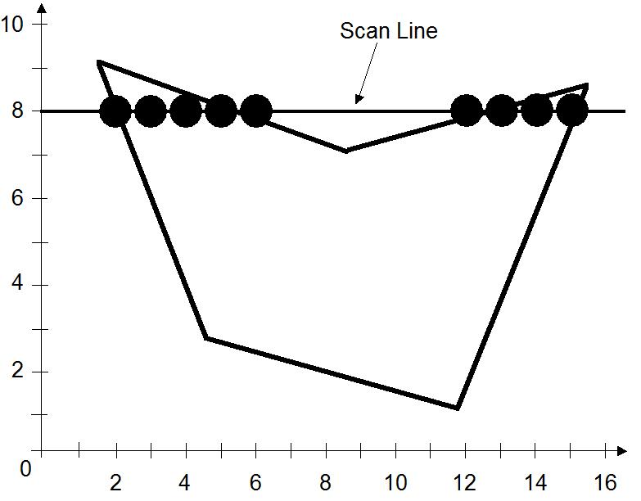
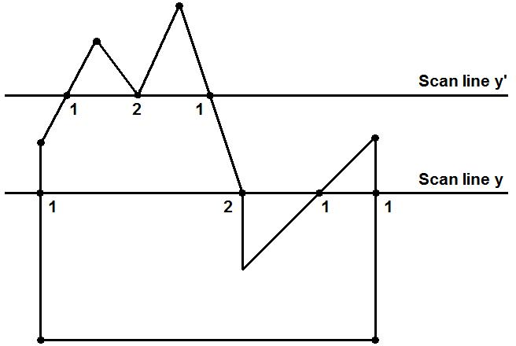
Scan line Algorithm

Slide 20
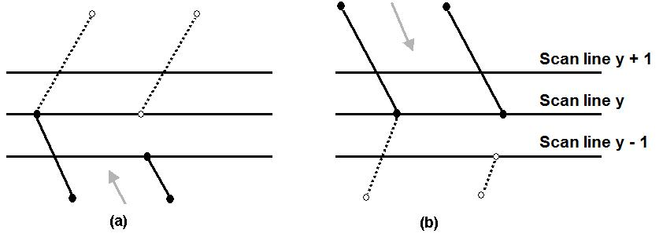
Scan line Algorithm – Dealing with vertices
When the endpoint y coordinates of the two edges are increasing, that means if they are on the same side of the scan line (as in inside-outside test), the y value of the upper endpoint for the current edge is decreased by one (a).
When the endpoint y values are decreasing, that means if the end points of the two edges are on the different sides of the scan line, the y value of the next edge is decreased by one (b).

Slide 21
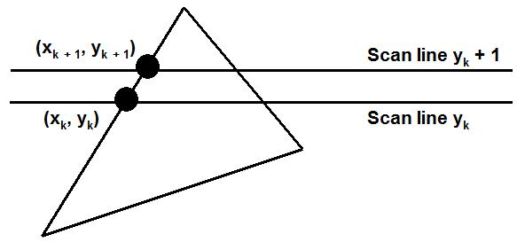
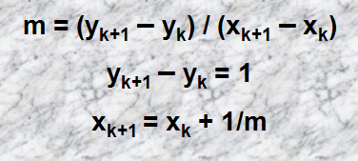
Scan line Algorithm – Coherence
Determining Edge Intersections:

Slide 22
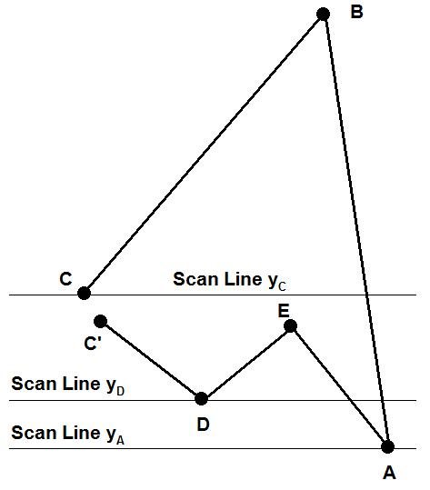
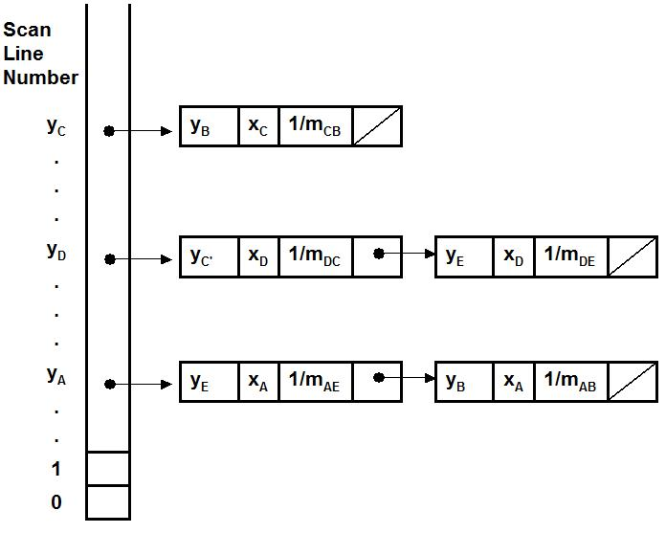
Scan line Algorithm – Coherence
Each entry in the table for a particular scan line contains the maximum y value for that edge, the x-intercept value (at the lower vertex) for the edge, and the inverse slope of the edge.

Slide 23
Thank You…

